Slide 1
Get off spread sheets!
An FX trading blotter from scratch

Slide 2
Infrastructure - Server and data base
Business – what you need to know
The problem
The concept
  Conponents

Slide 3
Business
What you need to know
Foreign Exchange Business
Selling and buying currency
Only one currency pair (USD/CRC)
Team composed of:
  1 Risk trader/manager
  2 sales traders
Customer base is given
Notes:
Customer analytics

Slide 4
The problem
How do we store executed transactions dealt with customers?
How does sales traders add new transactions
How to calculate FX position
Calculate PnL and EoD Profit n Loss report
Customer analytics
Notes:
We need than can track all transactions and positions of currencies.

Slide 5
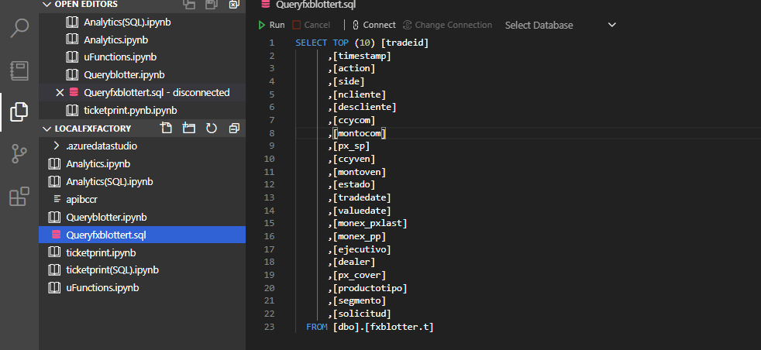
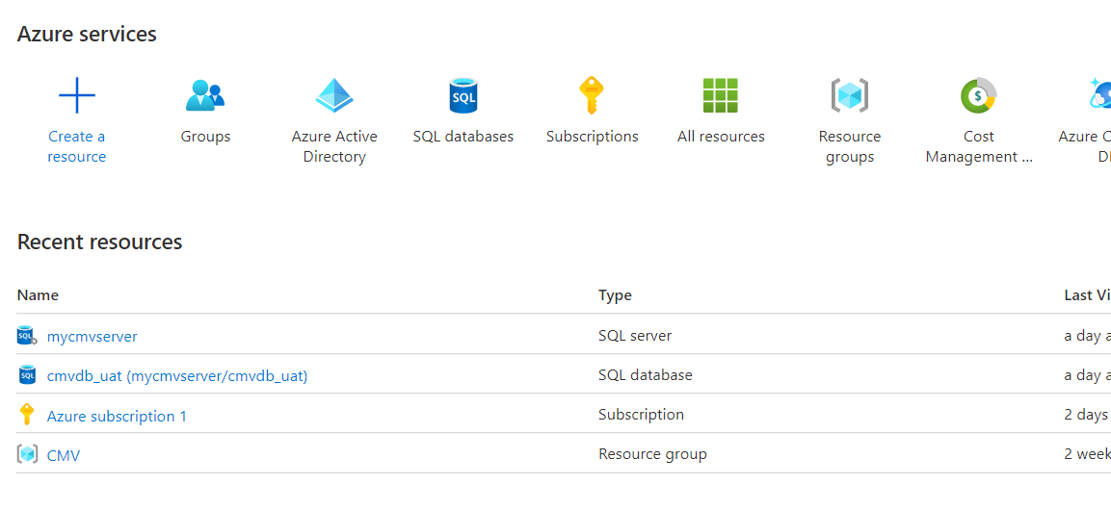
Infrastructure - Server
Azure SQL subscription
Server on Azure SQL
Azure Data Studio + MSFT SQL server

Slide 6
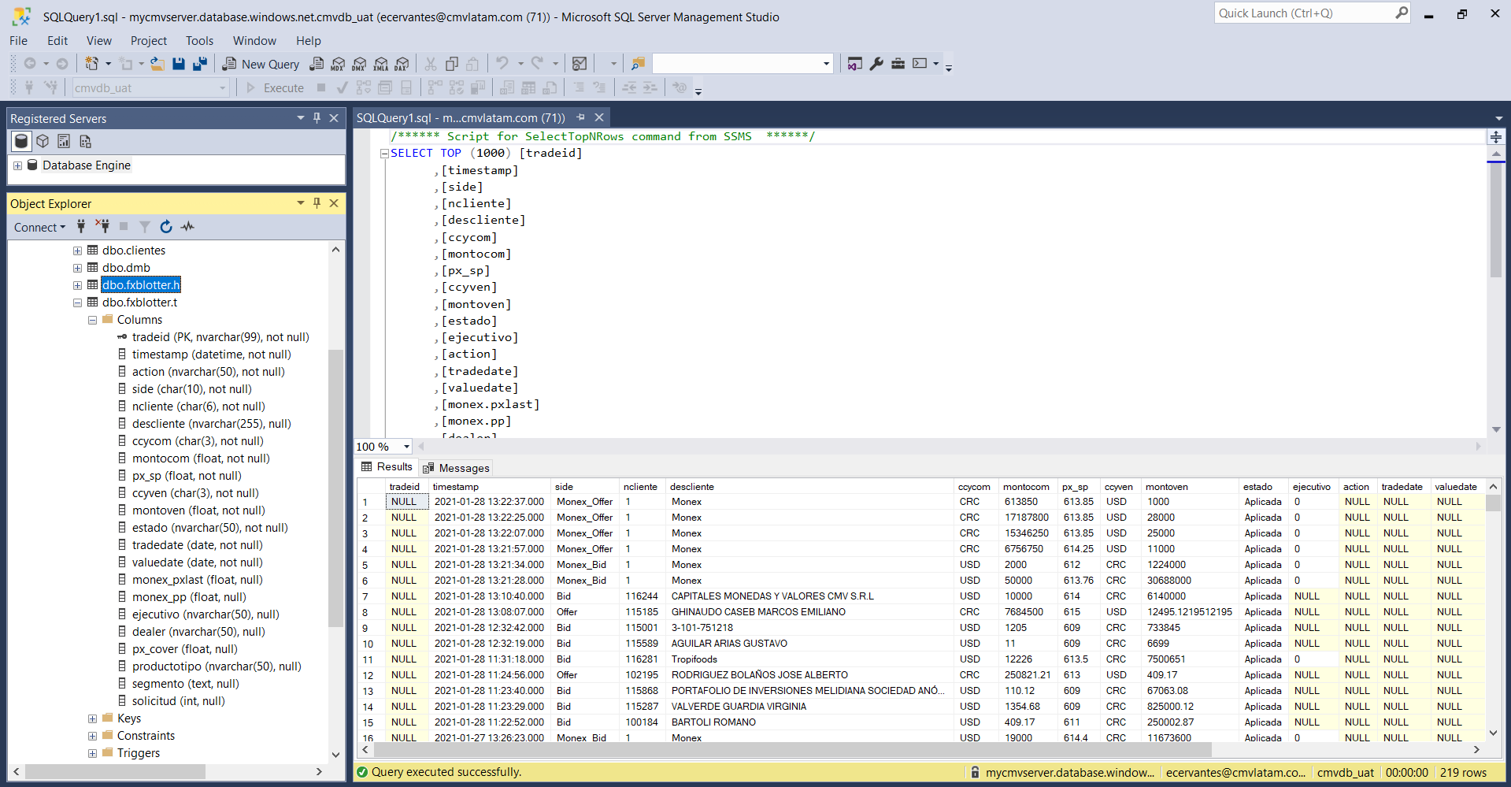
Infrastructure - Database
Testing database CMV_uat
Database design (schema)

Slide 7
The concept
cmvdb_uat (testing database)
Journal principle, Every transaction most be registered
Ticket_print function
inserts a new "trade" or line into the dbo.fxblotter.t (transactions)
Risk Management Read function for cmvdb_uat
(Math calculation problem) analytics: Fx position
Calculate PnL and EoD Profit n Loss report
NightVision - "the tool for sales traders"
reads information from fxblotter.h
Rolling Analytics (20day, 10day, 5day; 20txs, 10txs, 5txs)
visualisation of historic spread flow
Aggregated analytics/metrics (total amount, total tickets, total clients, avg ticket bid, avg ticket offer)

Slide 8

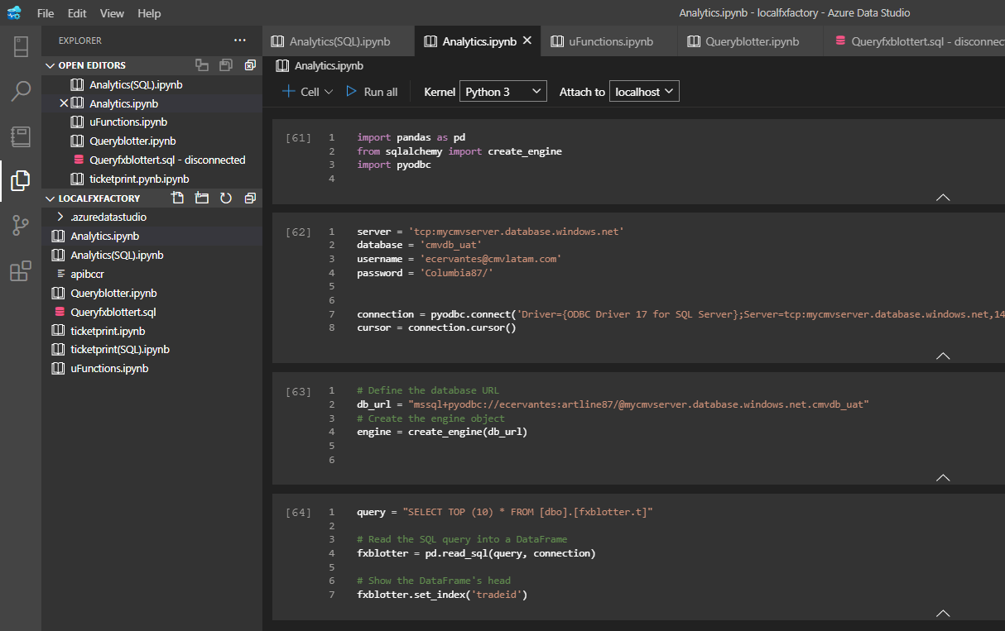
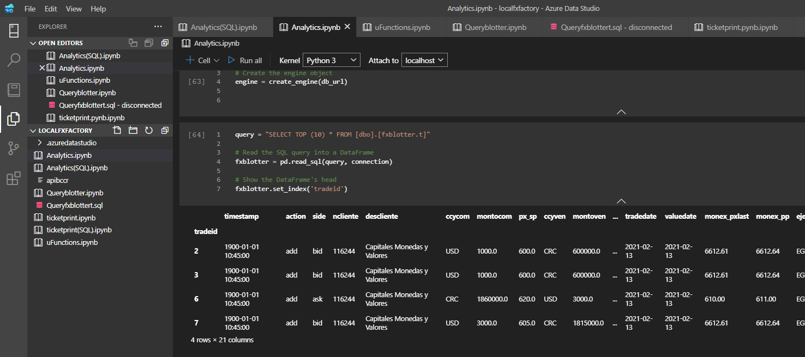
Connection and query data

Slide 9

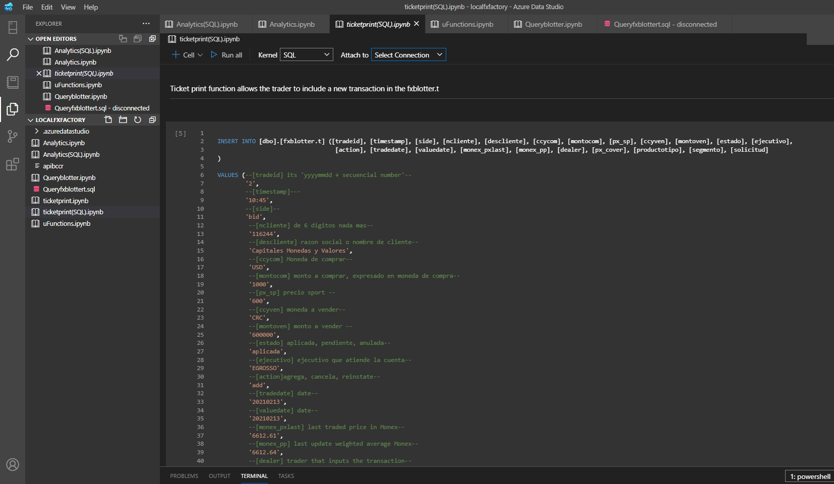
Ticket_print function
inserts a new "trade" or line into the dbo.fxblotter.t (transactions)

Slide 10
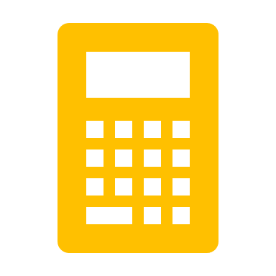
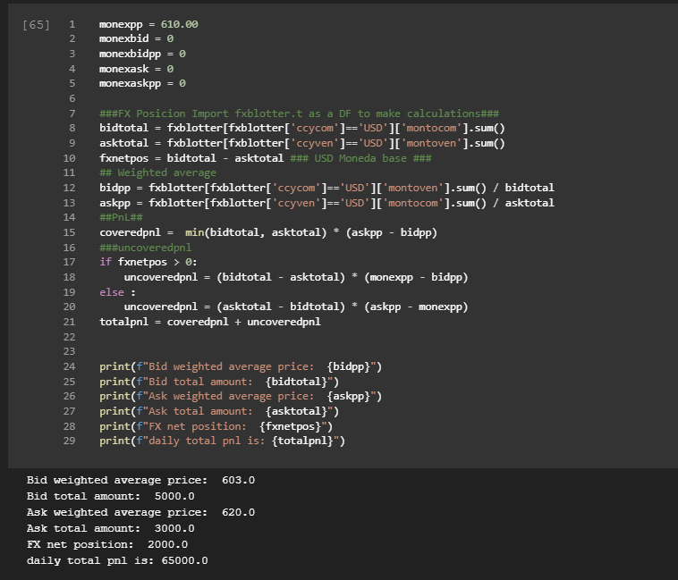
Risk Management Read function for cmvdb_uat
(Math calculation problem) analytics: Fx position

Slide 11
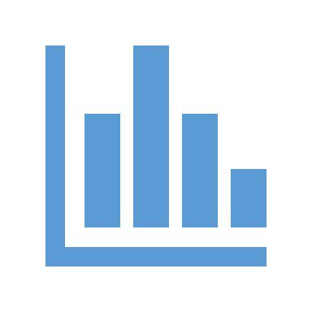
Calculate PnL and EoD Profit n Loss report

Slide 12



NightVision - "the tool for sales traders"
Under construction

